Slide 1
Authentication Methods

Slide 2
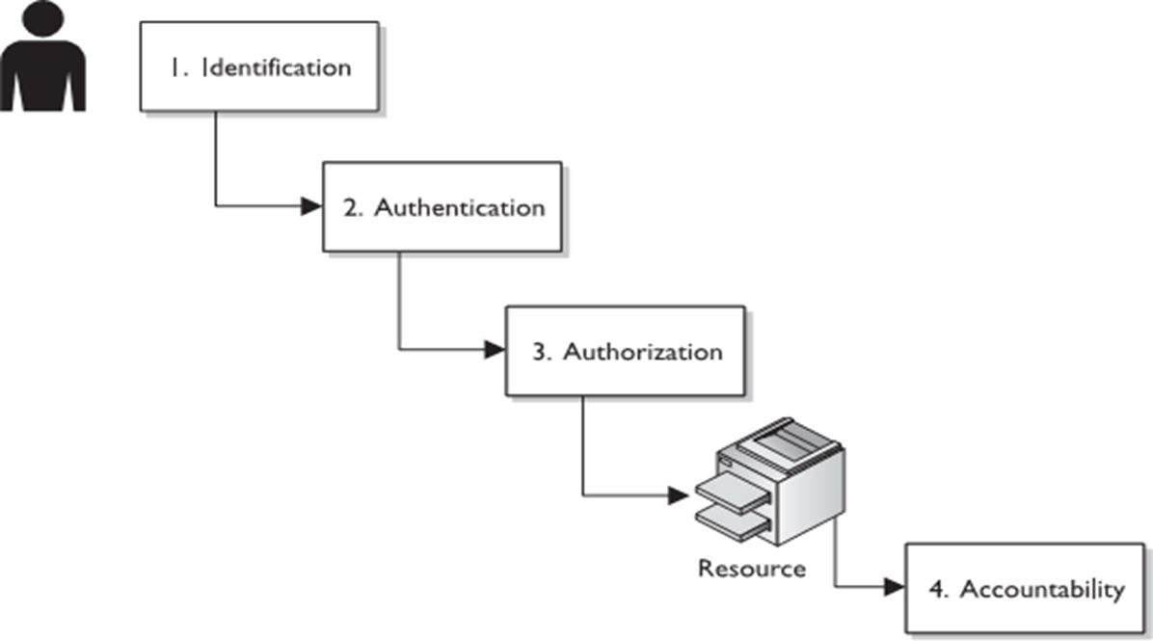
Authentication Process
Introductory Concepts
Identification
Authentication
Authorization
Accountability
Non repudiation

Slide 3
Authentication Process
Identification
a way to claim an entity’s presence with respect to the process being carried out.
Email, phone no.
Aadhaar card, Pan card, voter id, admit card, debit card
Authentication
It is a term that refers to the process of proving that some fact or some document is genuine.
In computer science, this term is typically associated with proving a user’s identity. Usually, a user proves their identity by providing their credentials, that is, an agreed piece of information shared between the user and the system.

Slide 4
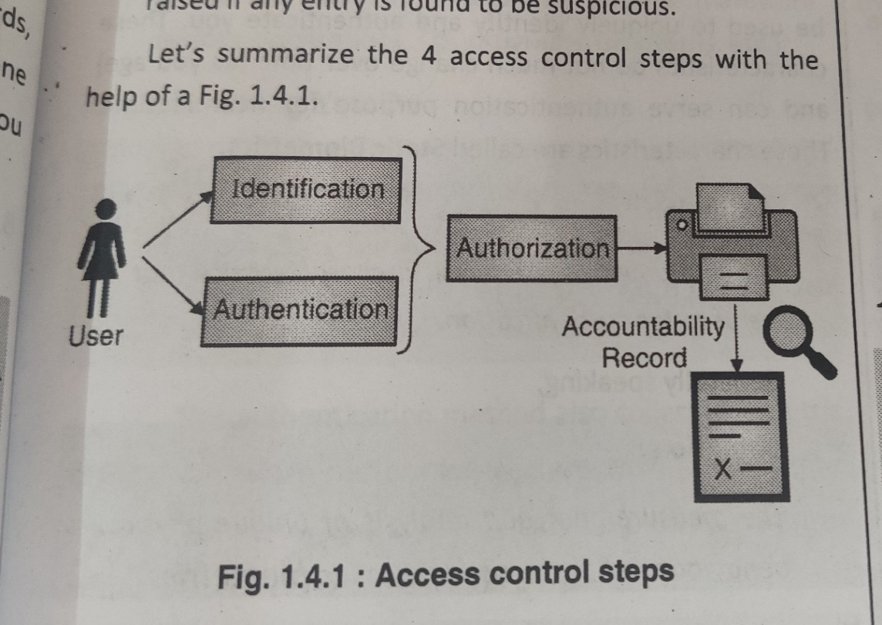
Authentication Process
Authorization
A way to determine what resource an entity can access..
Accountability
Is a way to record your actions..
Non repudiation
Is a way to prove your actions..

Slide 5
Authentication Methods
At a high level, authentication methods are categorized as:
Something you know
Something you have
Something you are
Something you do
Somewhere you are

Slide 6
Types of Authentication Methods
At a high level, authentication methods are categorized as:
Something you know
Password, PIN, secret question – mother’s maiden name, Pet name, first car purchase year, school name, city
Something you have
Physical keys, badge, swipe card, digital certificate, security keys(private key), OTP, token

Slide 7
Types of Authentication Methods
At a high level, authentication methods are categorized as:
Something you are
Biometrics
Fingerprint, palm scan, hand geometry, retina scan, iris scan, facial recognition
Something you do
Dynamic biometrics
Voice print, keystroke dynamics(hard press/ fast press) , handwriting
Somewhere you are
Location awareness(mobile phone, laptop)
Google smart lock for Android (you can set trusted locations

Slide 8
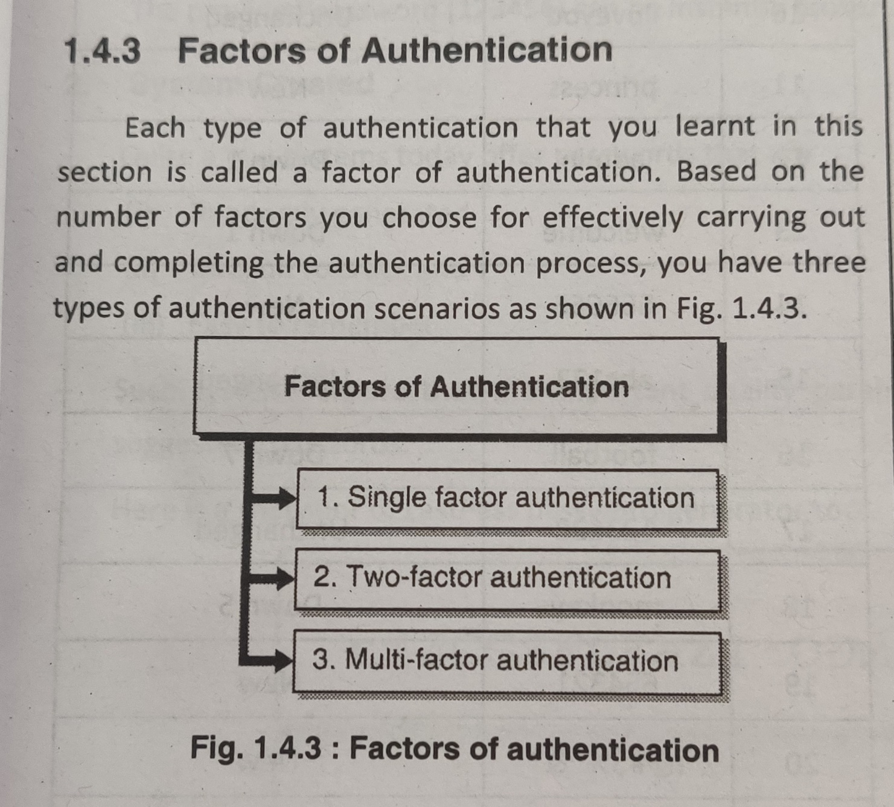
Factors of Authentication

Slide 9
Factors of Authentication
Single Factor Authentication
Requires only one type
Password, token, debit card, PIN
Weak form of authentication
Two-factor Authentication
Two forms
Any single followed by otp
Multi-factor Authentication
More than two types

Slide 10
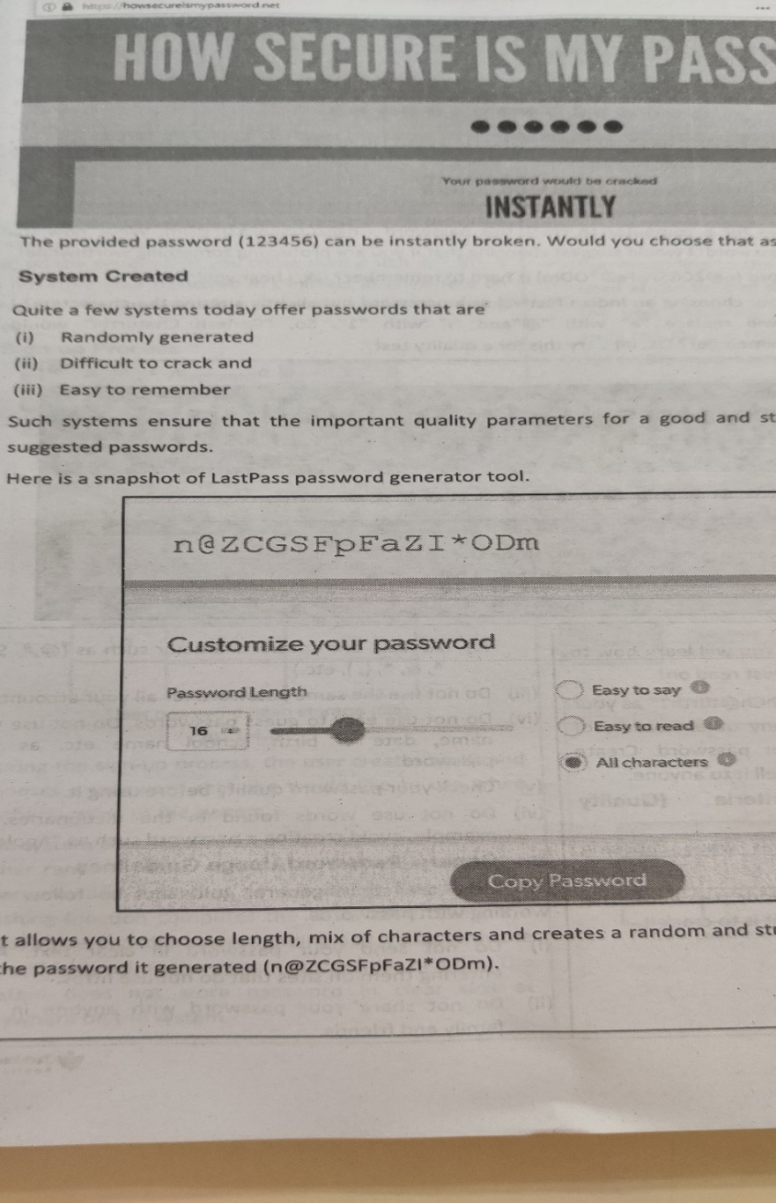
Types of Authentication
Password Based Authentication
Choosing a password
User Created
System generated

Slide 11
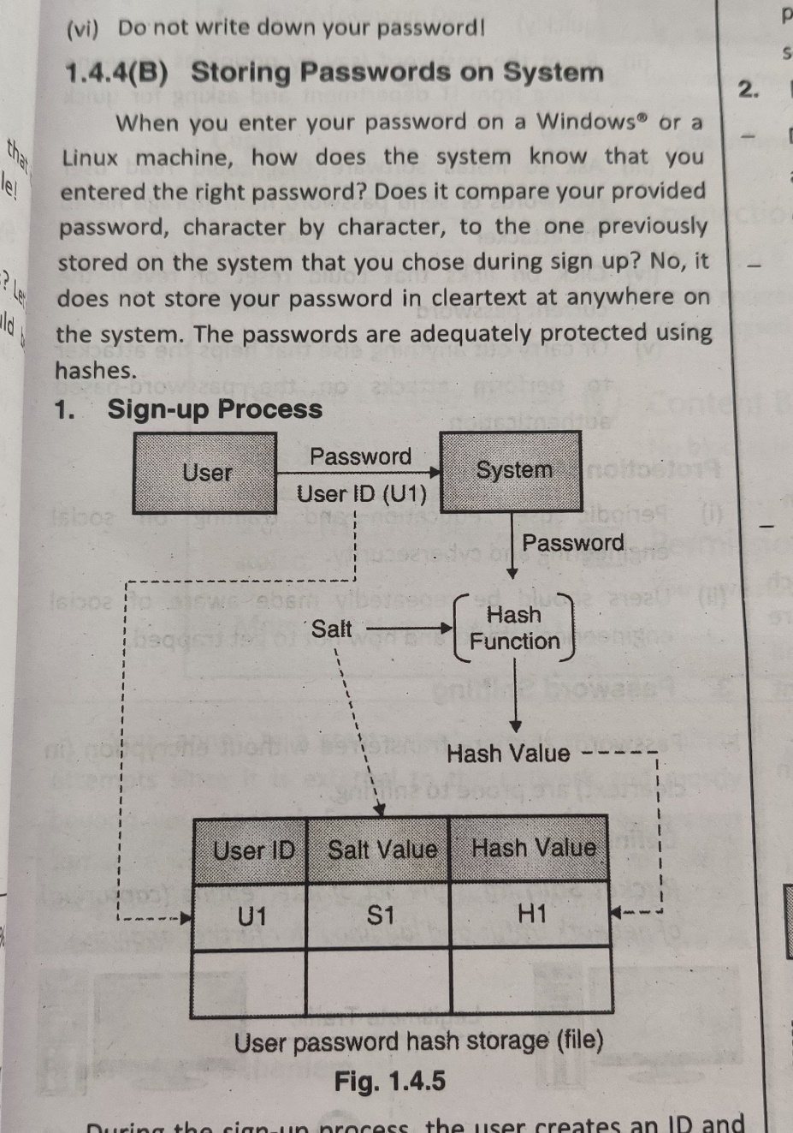
Types of Authentication
Storing Passwords on System
Sign-up process
Verification process

Slide 12
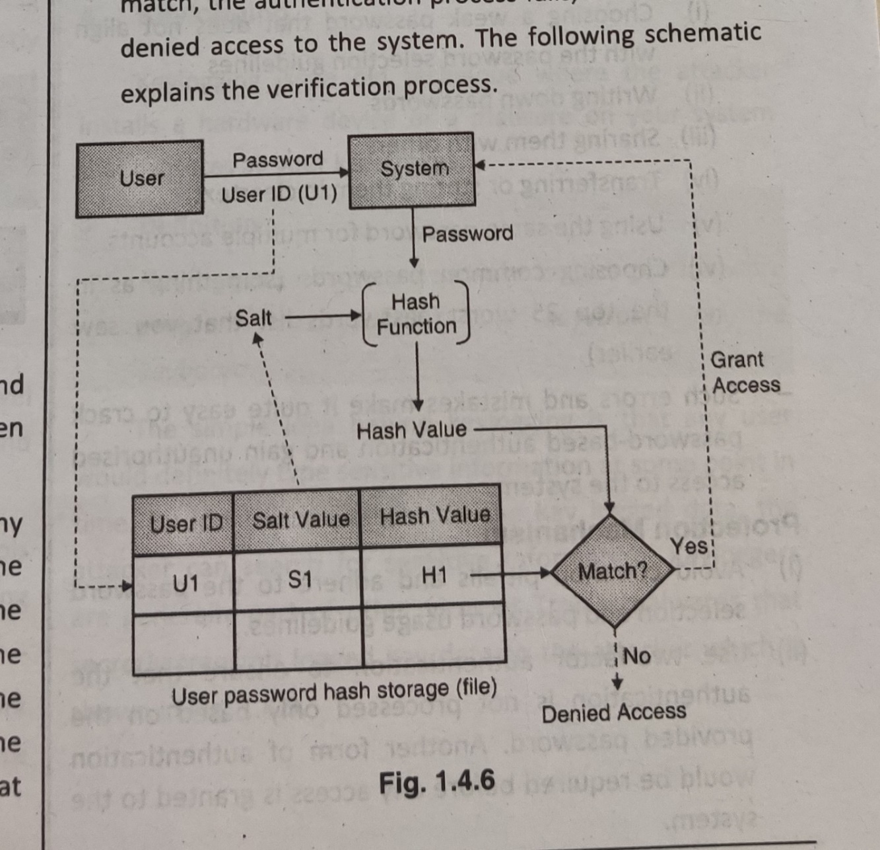
Types of Authentication
Storing Passwords on System
Sign-up process
Verification process

Slide 13
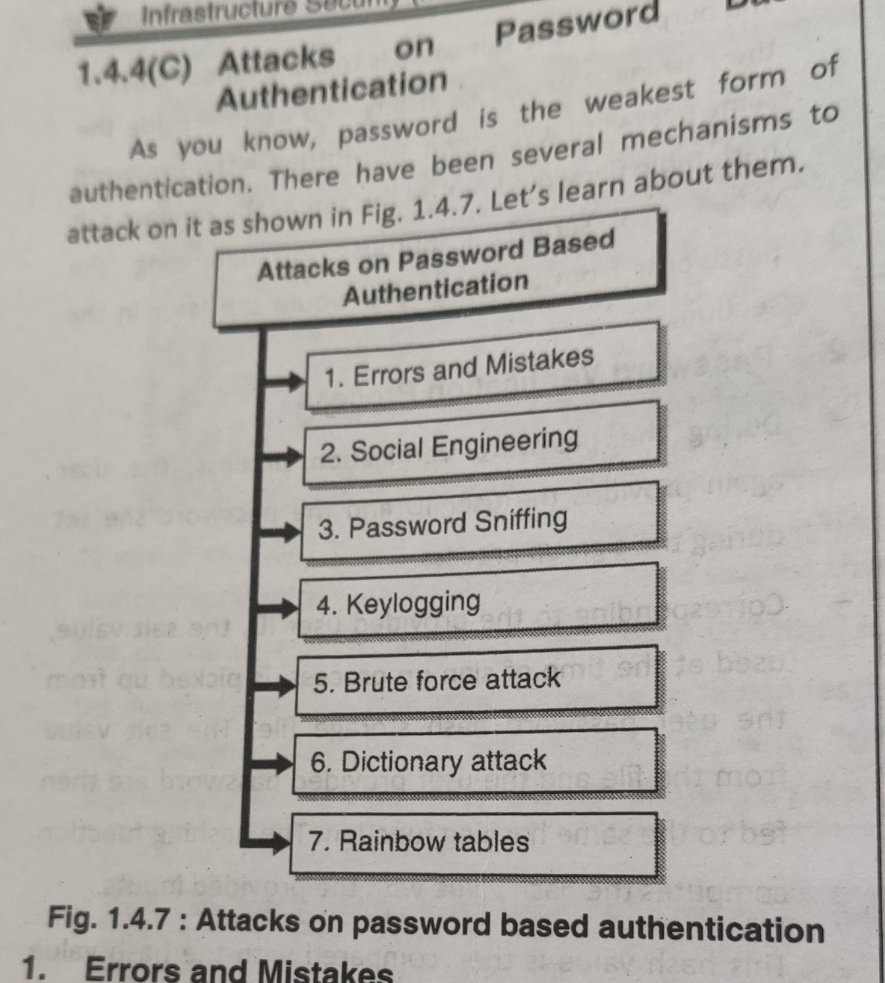
Attacks on Password Based Authentication

Slide 14
Attacks on Password Based Authentication
Errors and Mistakes
Choosing a weak password
Writing down/ sharing with others
Transferring/ storing in a clear text
Using same password for multiple accounts
Choosing common passwords
Protection Mechanism
Avoid common pitfalls and adhere to the password selection and usage guidelines.
Use two-factor authentication

Slide 15
Attacks on Password Based Authentication
Social Engineering (users are sometimes tricked to..)
Reveal the current password
Reset the password
Ask to install software that could read/ send passwords
Protection Mechanism
Periodic user education and training on social engineering
Make users aware about the social engineering attacks

Slide 16
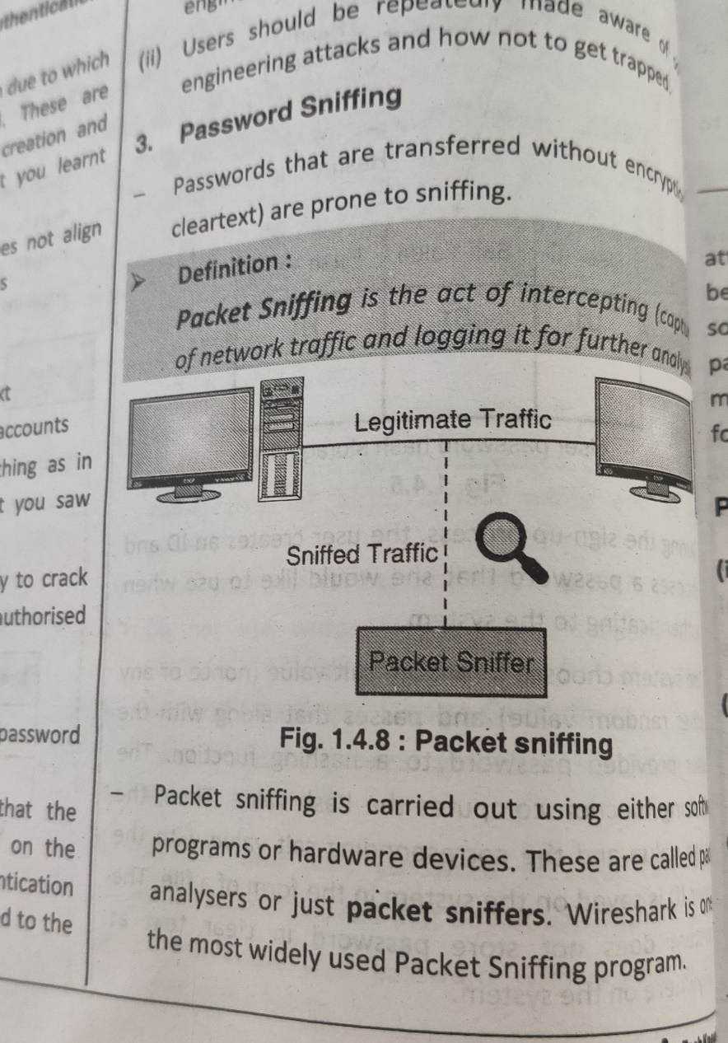
Attacks on Password Based Authentication
Password Sniffing
Passwords transferred without
encryption are prone to sniffing
Network sniffing
Protection Mechanism
Encryption
Use secure protocols
Isolate and segment networks

Slide 17
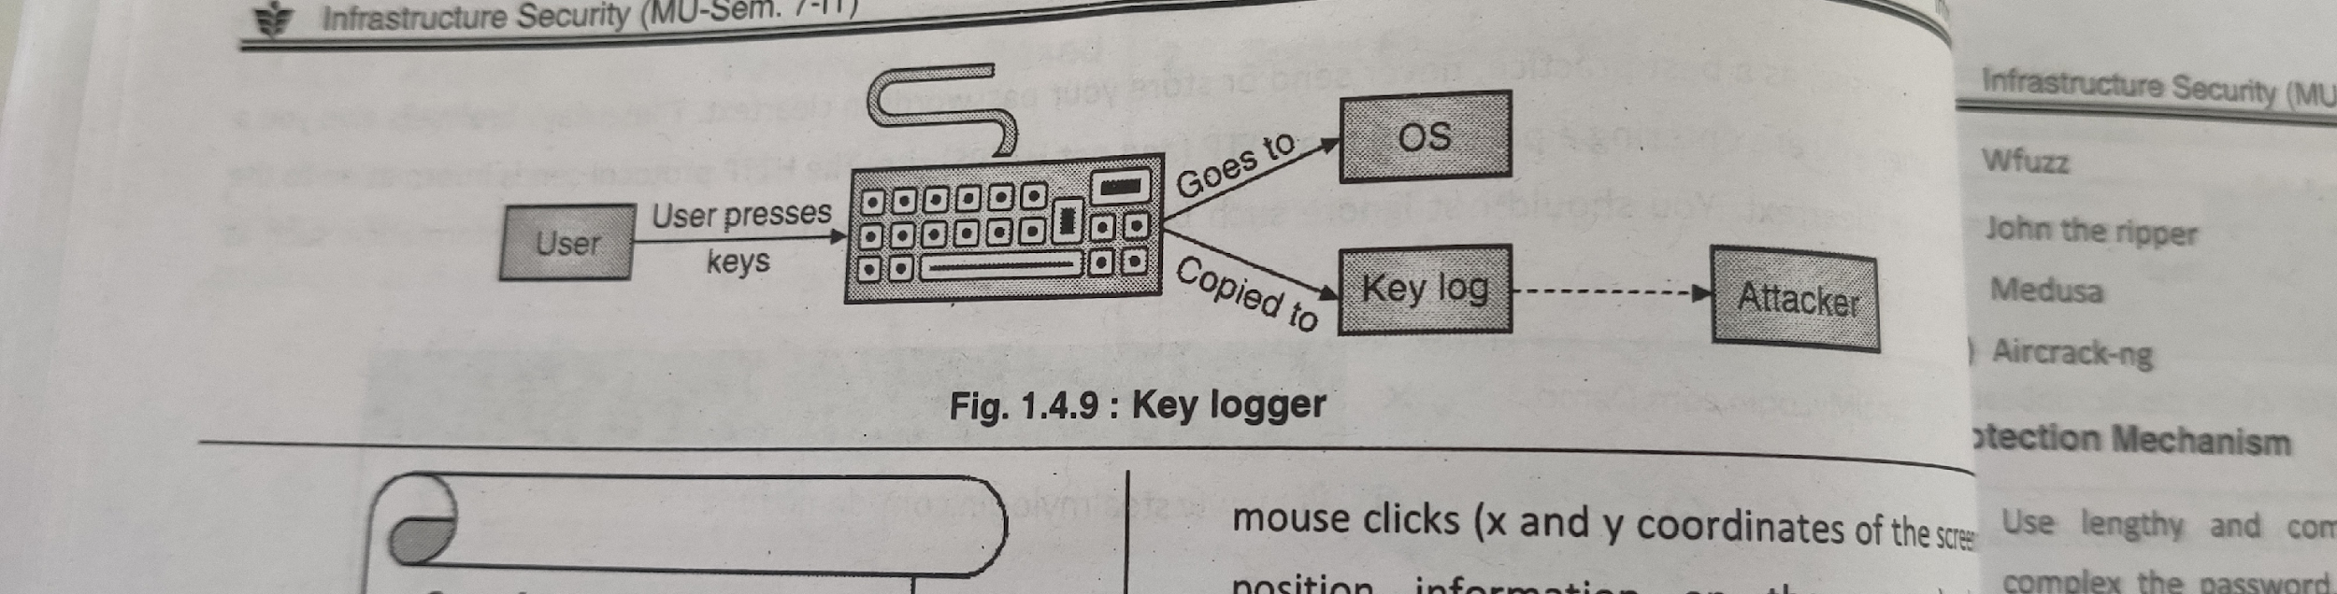
Attacks on Password Based Authentication
Keylogging
Key loggers or simply keystroke loggers are malware programs that capture keystrokes on the keyboard.

Slide 18
Attacks on Password Based Authentication
Keylogging
Key loggers or simply keystroke loggers are malware programs that capture keystrokes on the keyboard.
Protection Mechanism
Use anti-malware programs to scan
Set multi-factor authentication
Use virtual keyboard especially when dealing with financial related logins
Regularly check installed program inventory
Regularly check the services running on your system
Physically inspect system wires and attachments

Slide 19
Attacks on Password Based Authentication
Brute Force Attack
Is performed using tools that cycle through various combinations of characters until a successful combination of characters is found
Some tools : brutus, rainbow crack, Cain and Abel
Protection Mechanism
Use lengthy and complex passwords
Introduce a time delay after a certain no of failed logins
Send login notification via mail or sms
Protect the password hash storage files

Slide 20
Attacks on Password Based Authentication
Dictionary Attack
Variation of brute force attack
Dictionary words and their variations are tried out
Dictionary can be in user’s native spoken language / multiple language
This may be faster than brute force attack
But all combinations are not tried

Slide 21
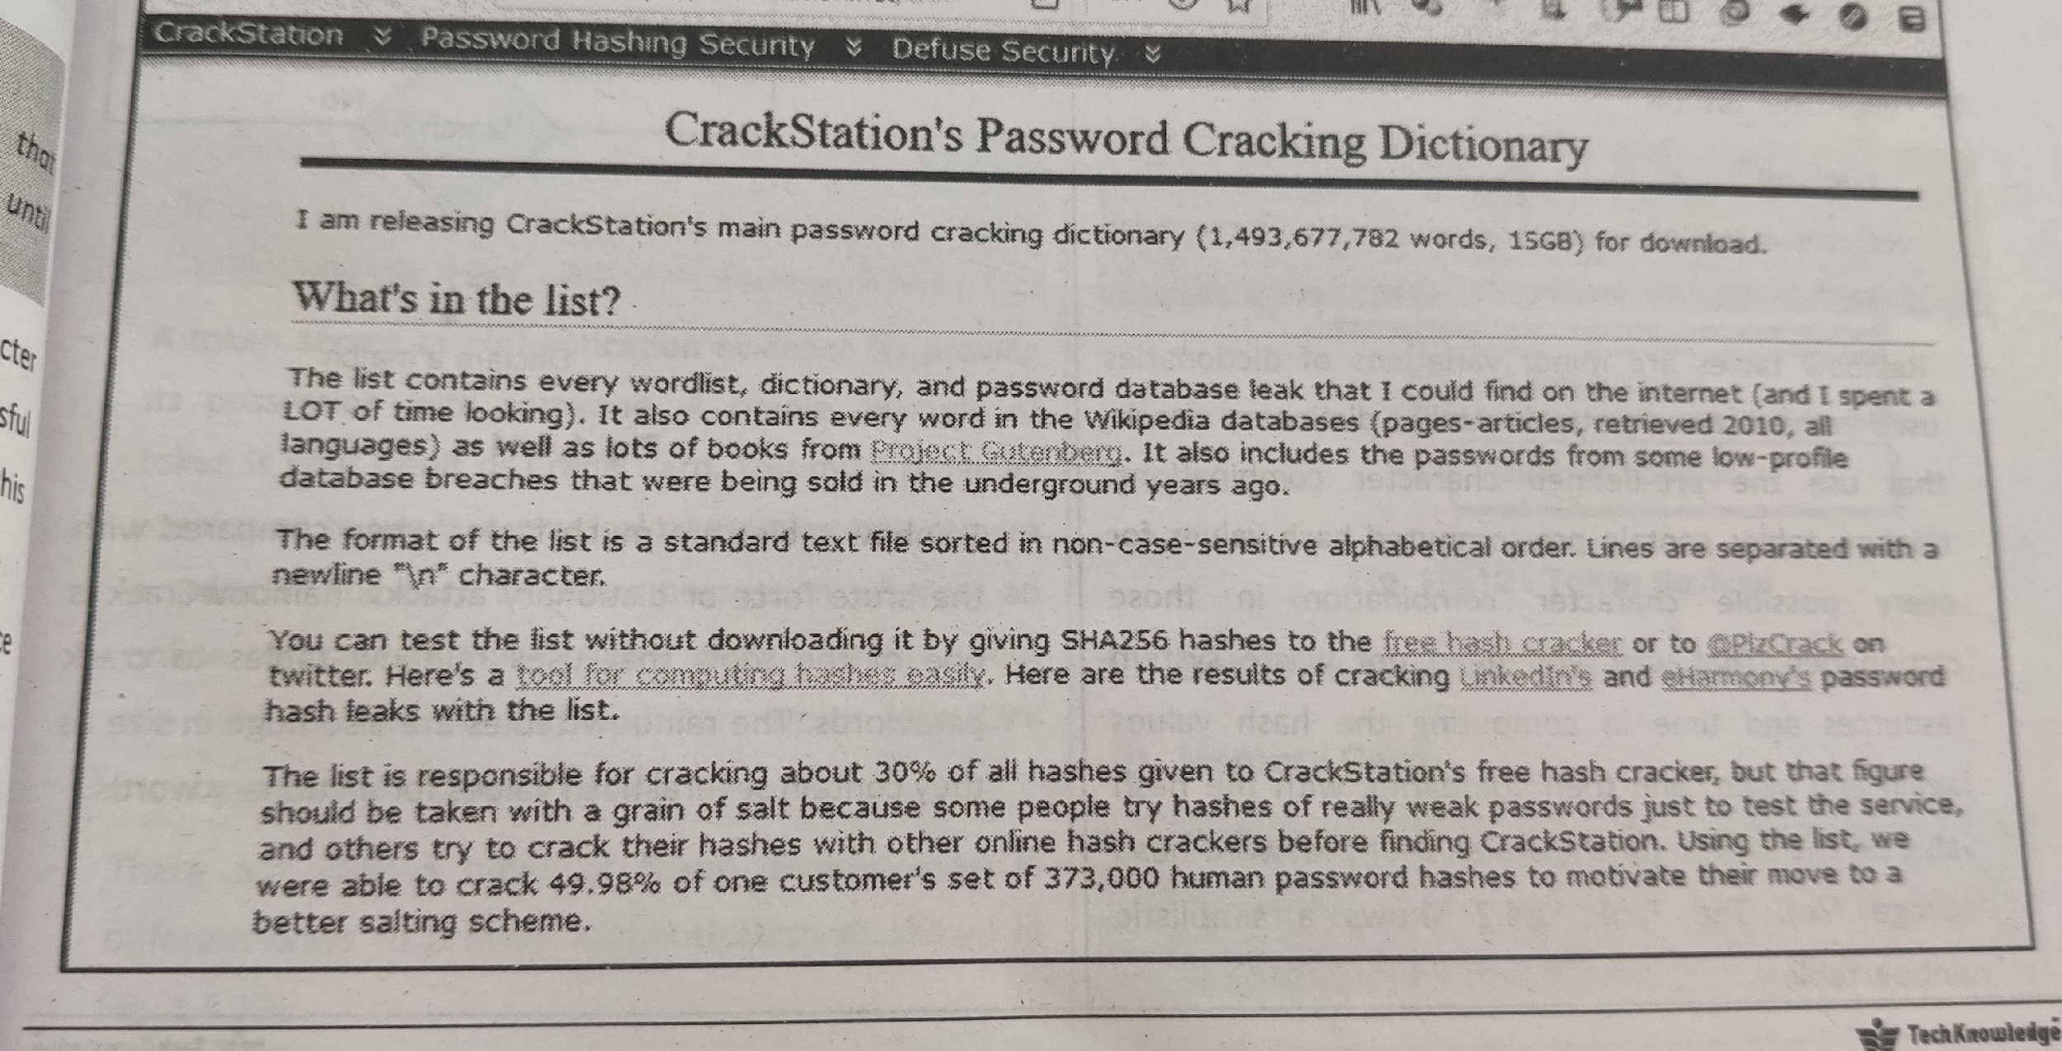
Attacks on Password Based Authentication
Dictionary Attack

Slide 22
Attacks on Password Based Authentication
Dictionary Attack
Protection Mechanism
Follow password selection guideline and choose a complex and no-dictionary password
Time delays after certain attempts
Send login notification
Protect the password hash storage files from unauthorized access or download

Slide 23
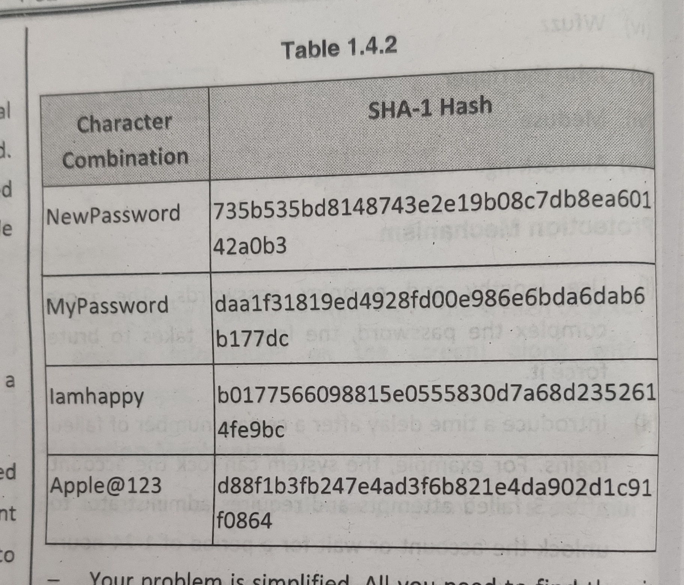
Attacks on Password Based Authentication
Rainbow Tables
This consists of passwords in the hash format

Slide 24
Attacks on Password Based Authentication
Rainbow Tables
This consists of passwords in the hash format
Protection Mechanism
Follow password selection guideline and choose a complex and no-dictionary password
Protect the password hash storage files from unauthorized access or download

Slide 25
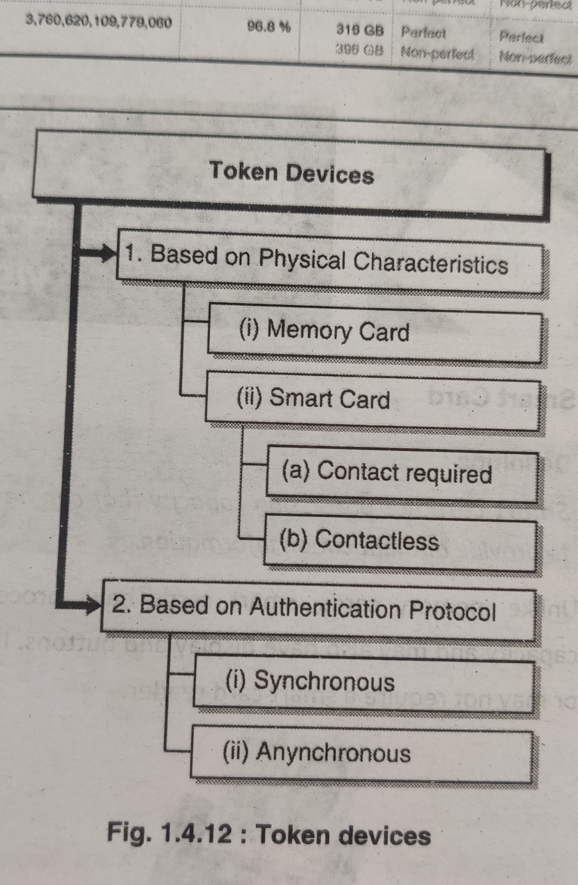
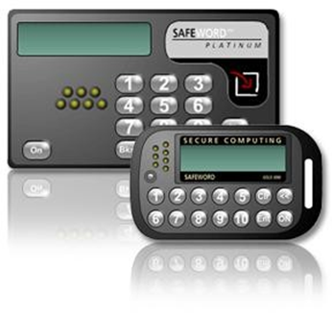
Token Based Authentication
Token
Token device, or password generator, is usually a handheld device that has an LCD display and possibly a keypad
– Token device is separate from the computer the user is attempting to access
Based on Authentication Tokens
Synchronous Tokens
Asynchronous Tokens

Slide 26
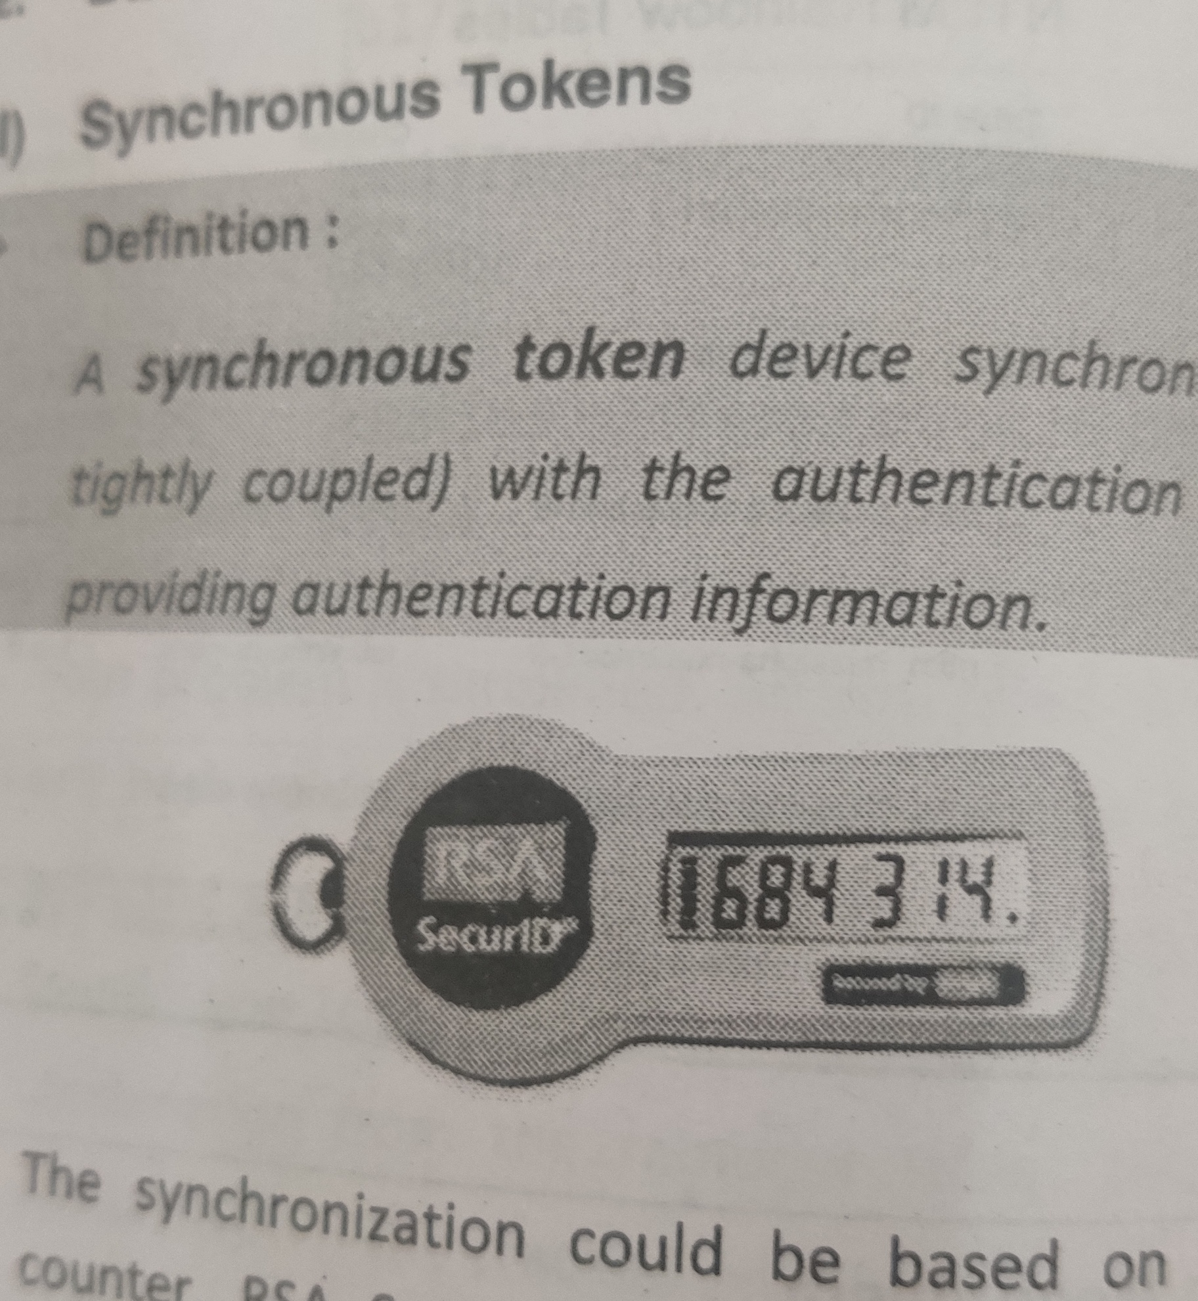
Token Based Authentication
Token
Token device, or password generator, is usually a handheld device that has an LCD display and possibly a keypad
Based on Authentication Tokens
Synchronous Tokens

Slide 27
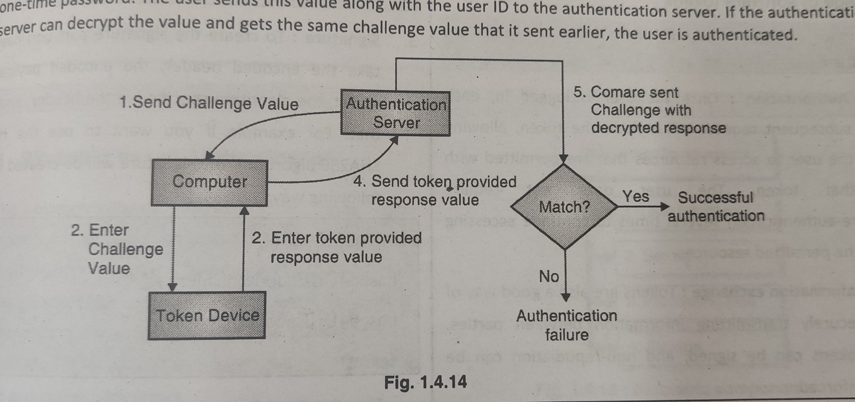
Token Based Authentication
Tokens based on Authentication Tokens
Asynchronous Tokens
Not time dependent
Challenge-response mechanism

Slide 28
Attacks on Token Based Authentication
Benefits
Not vulnerable to electronic eavesdropping
Wiretapping
Sniffing
Provide two factor authentication
Limitations
Human error
Battery limitation
Token itself (Environmental factors)

Slide 29
Biometric Based Authentication
Biometric based Authentication relies upon
Something you are
Your body characteristics
Something you do
Your actions

Slide 30
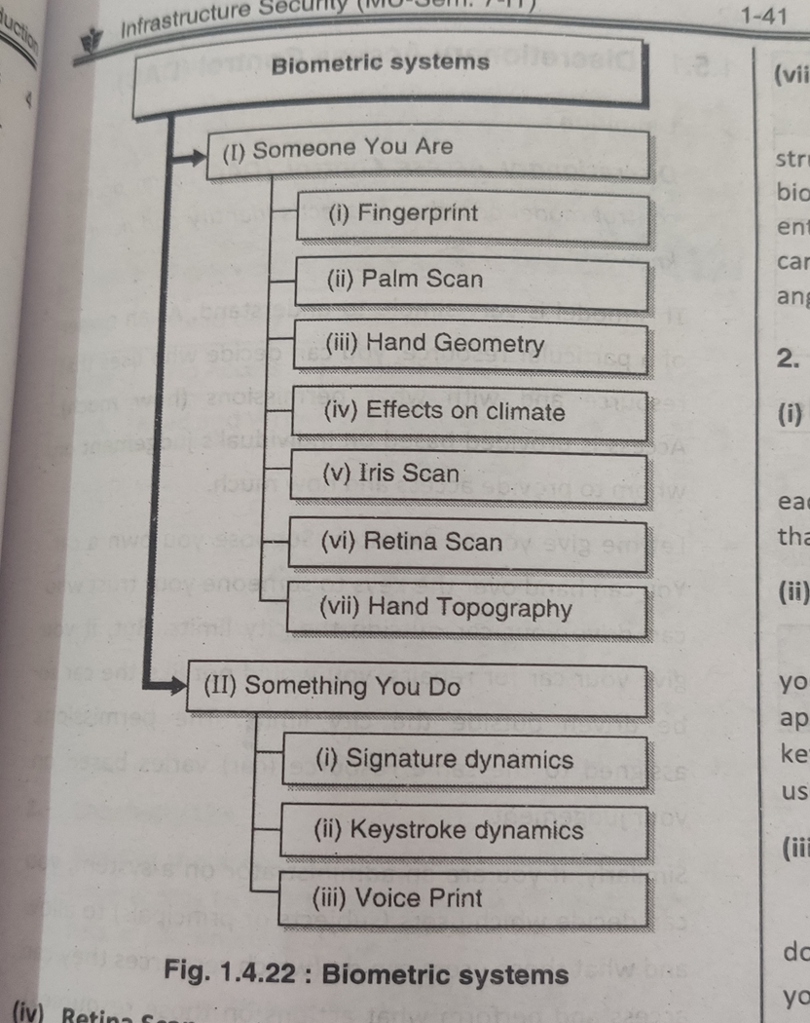
Biometric Based Authentication
Biometric Components
User interface
Sensor
Processing unit
storage

Slide 31
Biometric Based Authentication

Slide 32
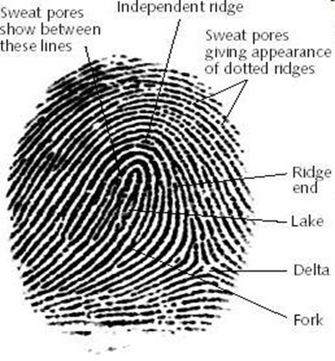
Biometric Based Authentication
Fingerprints
Every person's fingerprint is unique
Most affordable and convenient method of verifying a person's identity
The lines that create a fingerprint pattern are called ridges and the spaces between ridges are called valleys.

Slide 33
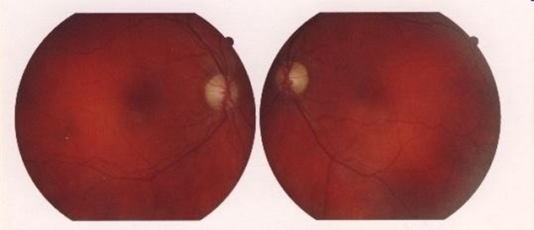
Biometric Based Authentication
Retina Scan
Retinal scan technology maps the capillary pattern of the retina
– A thin (1/50th inch) nerve on the back of the eye!
Accurate
Many people are hesitant to use the device ☹

Slide 34
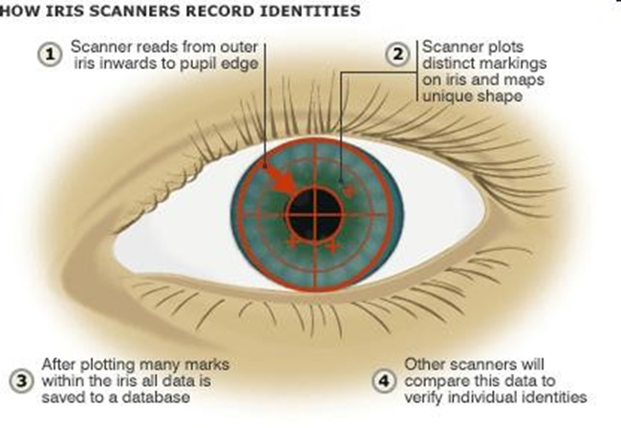
Biometric Based Authentication
Iris Scan
Scans the iris or the colored portion of the eye
For authentication the subject looks at the video camera from a distance of 3-10 inches
The entire enrollment process is less than 20 seconds, and subsequent identification takes 1-2 seconds.
Offers high accuracy!

Slide 35
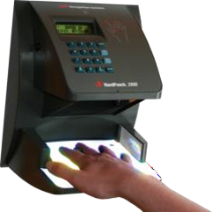
Biometric Based Authentication
Hand Geometry
Measures specific characteristics of a person's hand such as length of fingers and thumb, widths, and depth.
Takes over 90 measurements of the length, width, thickness, and surface area of a person's hand and fingers.
Hand measurements occur with amazing speed, almost within one second.
A charge coupled device (CCD) digital camera is used to record the hand's three dimensional shape.

Slide 36

Biometric Based Authentication
Keyboard Dynamics
Looks at the way a person types at a keyboard
Also called Typing Rhythms!
Keyboard dynamics measures two distinct variables:
Dwell time: The amount of time one holds a particular key
Flight time: The amount of time one moves between the keys
Keyboard dynamic system can measure one's keyboard input up to 1000 times per second!

Slide 37
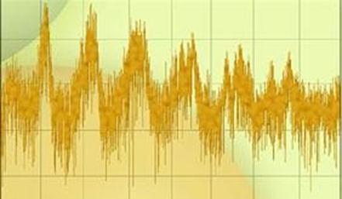
Biometric Based Authentication
Voice Print
A voice reference template is constructed
To construct, an individual must speak a set of phrases several times as the system builds the template.
Voice identification systems incorporate several variables including pitch, dynamics, and waveform.

Slide 38
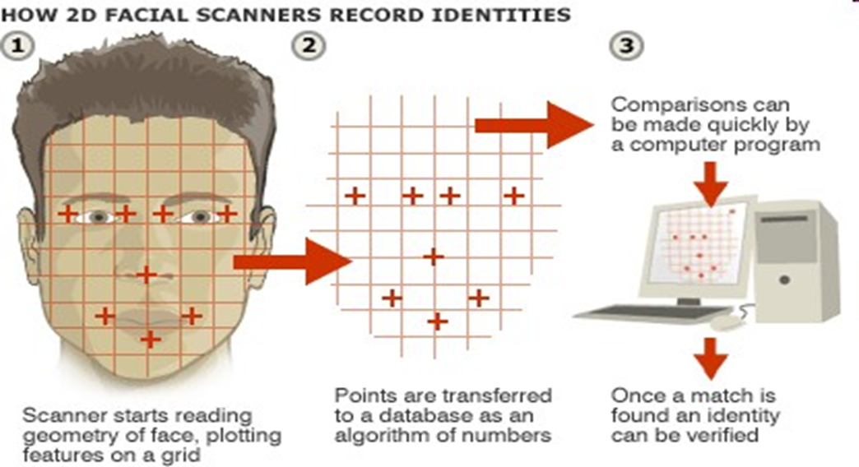
Biometric Based Authentication
Facial Scan

Slide 39
Biometric Based Authentication
Facial Scan
Incorporates two significant methods:
Detection
Recognition
Detection involves locating the human face within an image.
Recognition is comparing the captured face to other faces that have been saved and stored in a database.

Slide 40
Biometric Based Authentication
Biometric Components
User interface
Sensor
Processing unit
storage

Slide 41
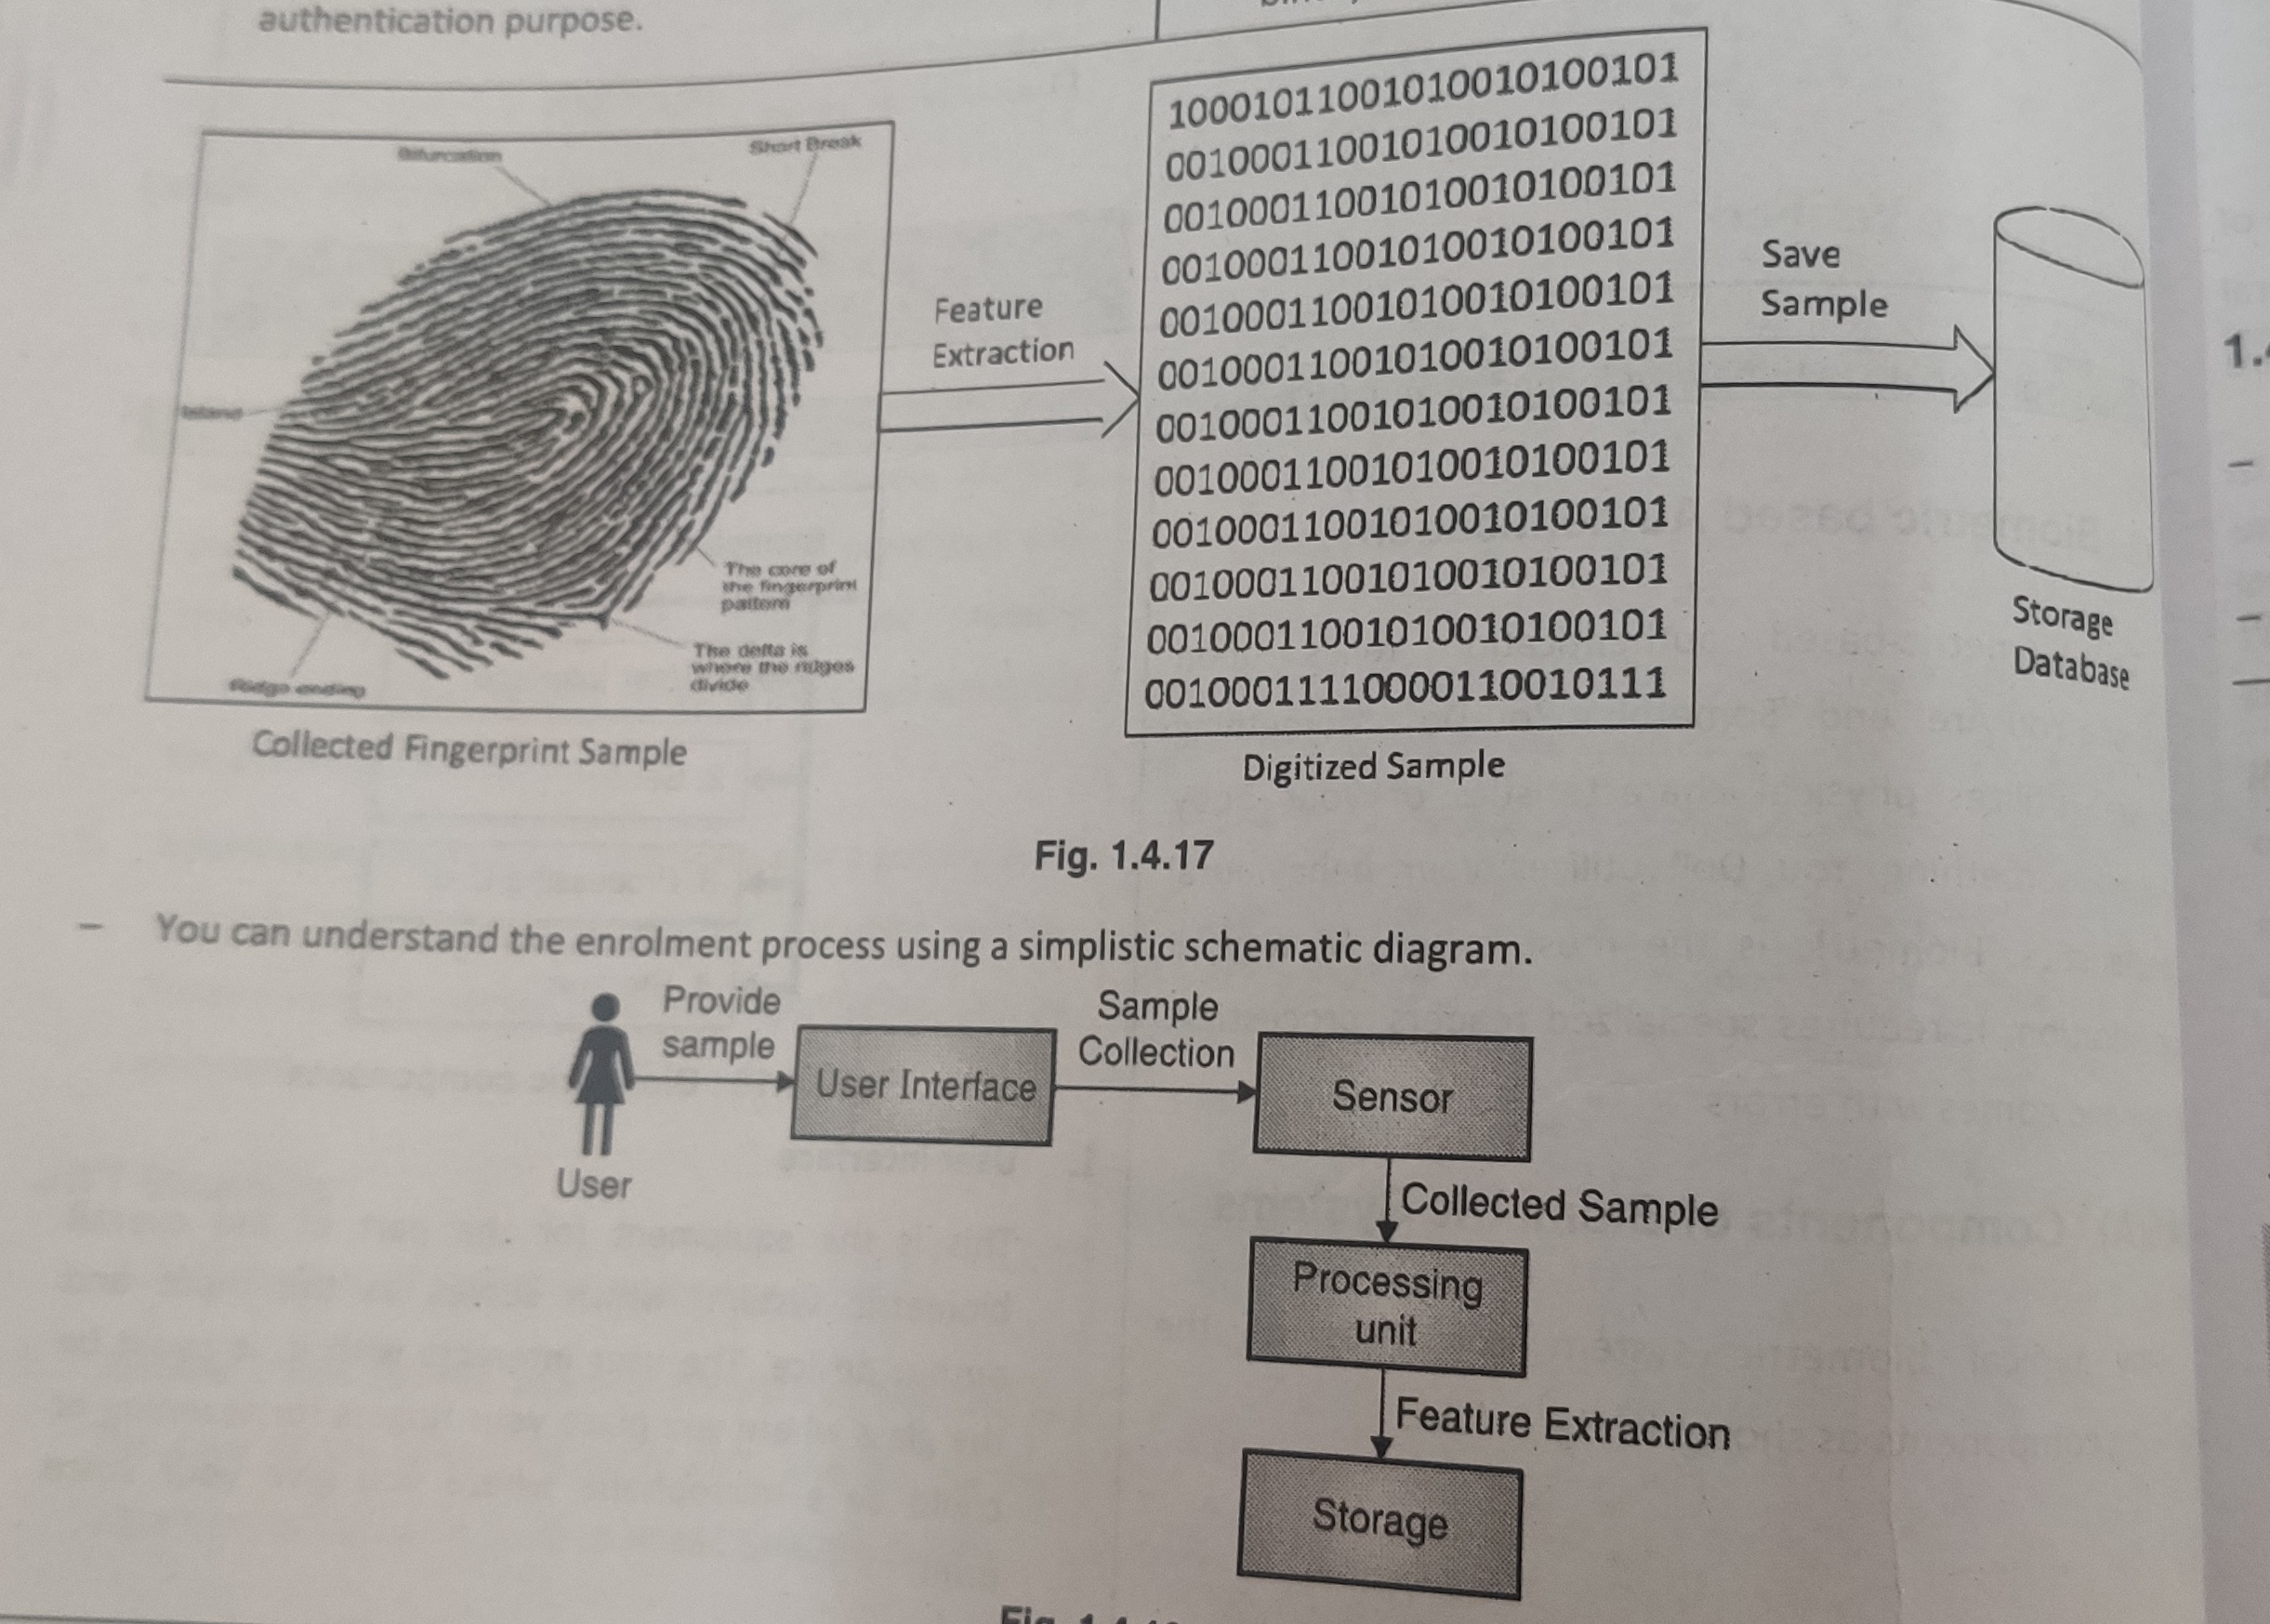
Biometric Based Authentication

Slide 42
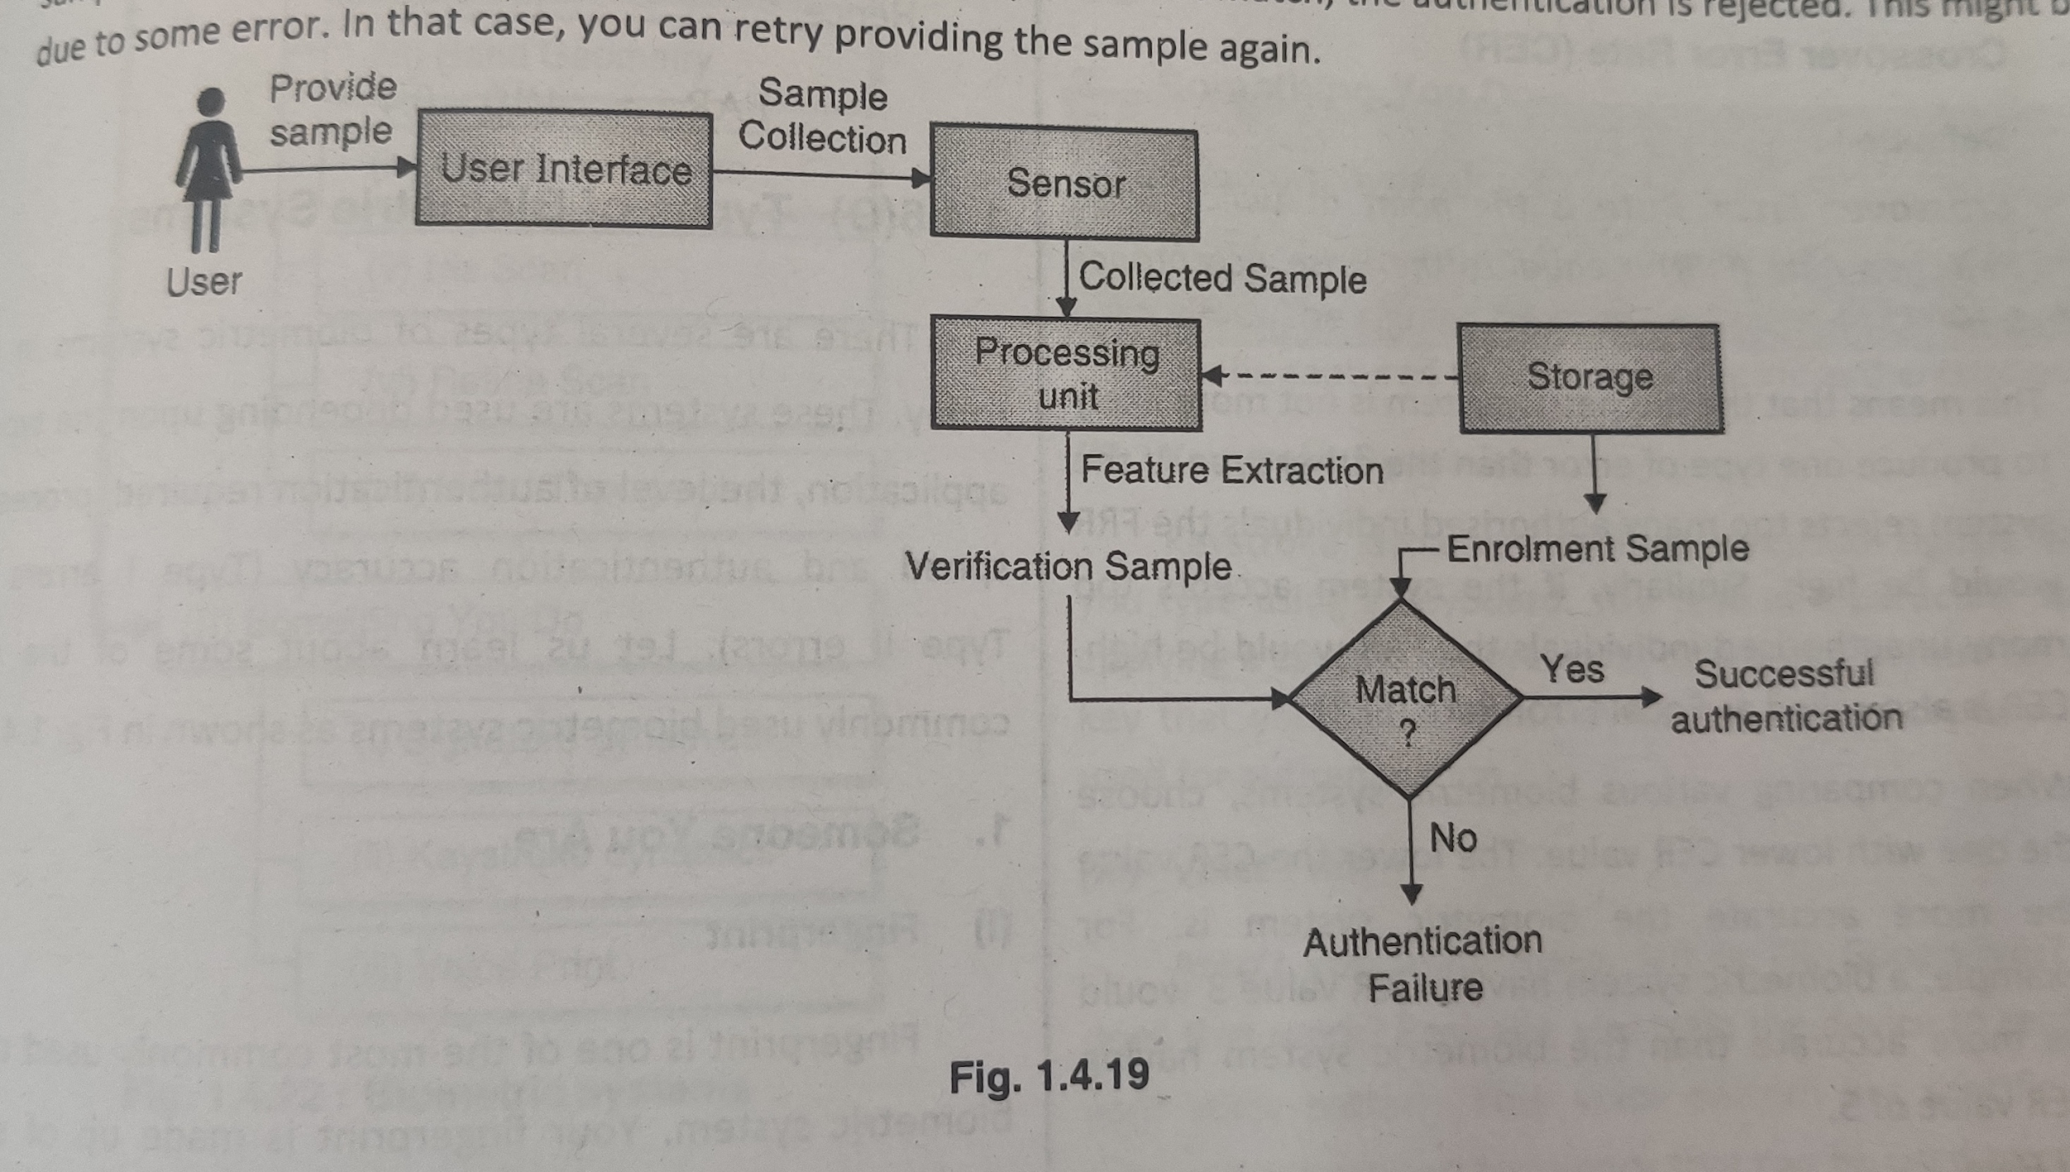
Biometric Based Authentication

Slide 43
Accuracy/ Performance of Biometric Based Authentication
Biometric performance is most commonly measured in two ways:
False Rejection Rate (FRR) – Type1
False Acceptance Rate (FAR) – Type 2
The FRR is the probability that you are not authenticated to access your account.
The FAR is the chance that someone other than you is granted access to your account.

Slide 44
Accuracy/ Performance of Biometric Based Authentication
Crossover Error Rate (CER)
Crossover Error Rate (CER) value is when Type 1 and Type 2 errors are equal.
(Type 1 = Type 2 errors) = CER metric value
System ABC has 1 out of 100 Type 1 errors = 1%
System ABC has 1 out of 100 type 2 errors = 1%
System ABC CER = 1
The lower the CER value, the higher accuracy
System with a CER of 5 has greater accuracy than a system with CER of 6

Slide 45
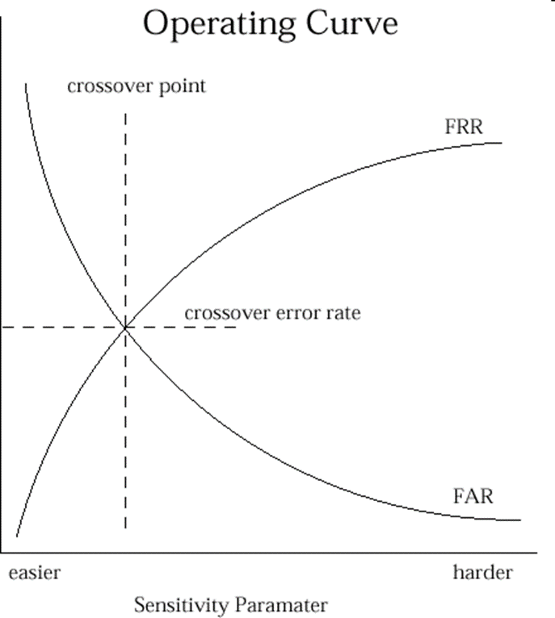
Accuracy/ Performance of Biometric Based Authentication

Slide 46
Comparison of biometric Based Authentication
Biometric System | Processing Speed | Accuracy | Ease of Enrollment
Finger Print | High | High | High
Palm scan | Medium | High | Medium
Hand Geometry | Low | Medium | Low
Retina scan | Medium | High | High
Iris scan | Medium | High | High
Facial scan | Medium | Low | Medium
Hand Topography | Low | Low | Low
Signature | Medium | Medium | Medium
Keystroke | Medium | Medium | Medium
Voice print | Medium | Medium | Medium

Slide 47
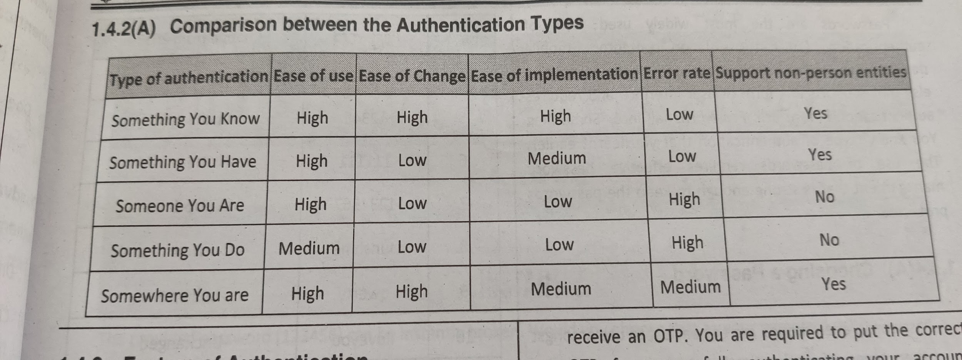
Authentication Methods

Slide 48
Thank you !

